Slide 1
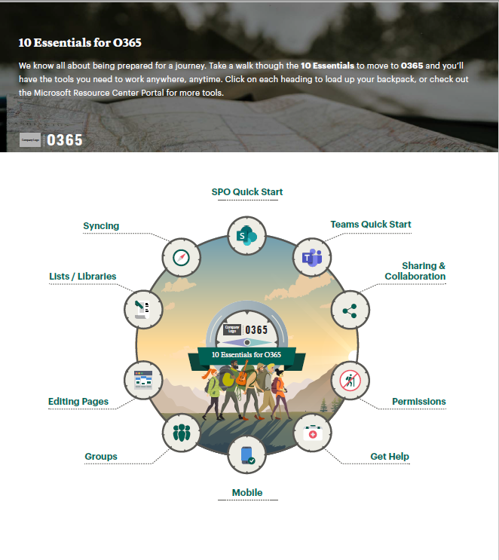
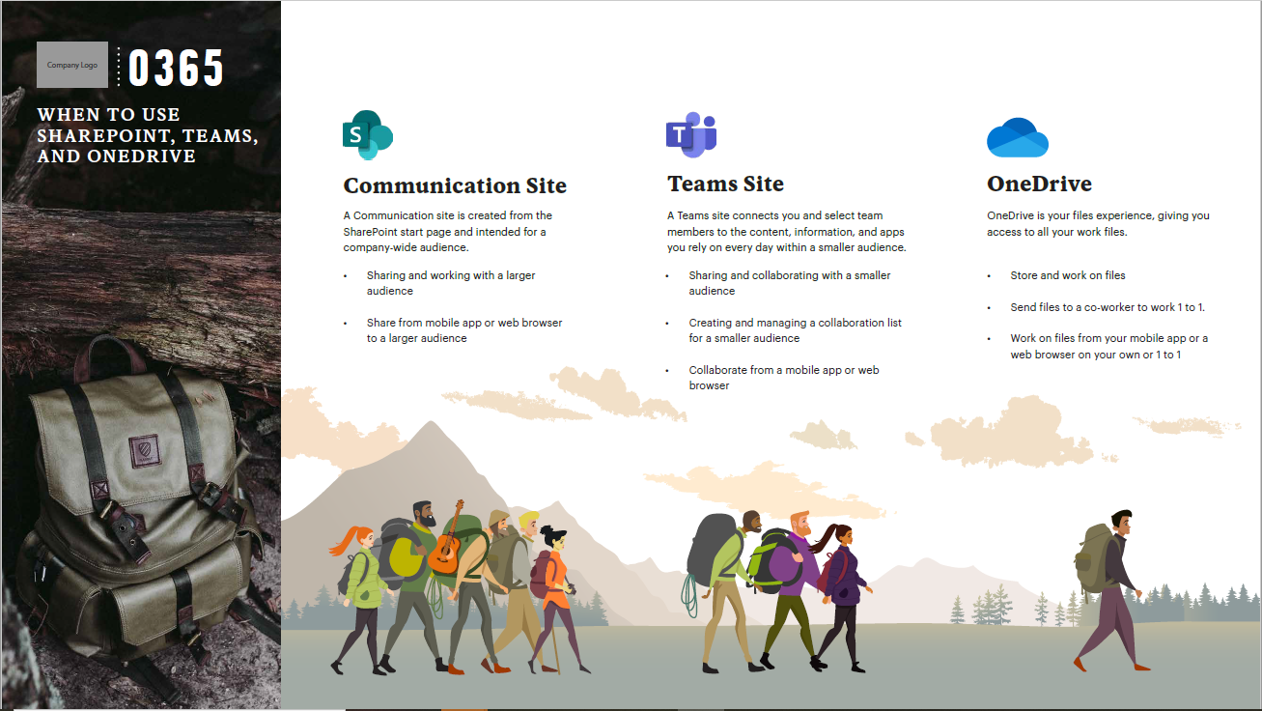
Retailer – O365 Migration, Teams Training & Change Management
Client Need
An audience using a variety of approved and unapproved tools need to be consolidated into a single platform (Teams), with detailed governance, road mapping, and a resistance users base.
What We Did
Planning and execution across technology, user adoption, and communications with an accelerated timeline.
Thorough communication plan and multi-touch approach.
Result:
100% of targeted users were successfully transitioned
99% of audience attending training reported that they were able to confidently use the tools after attending

Slide 2
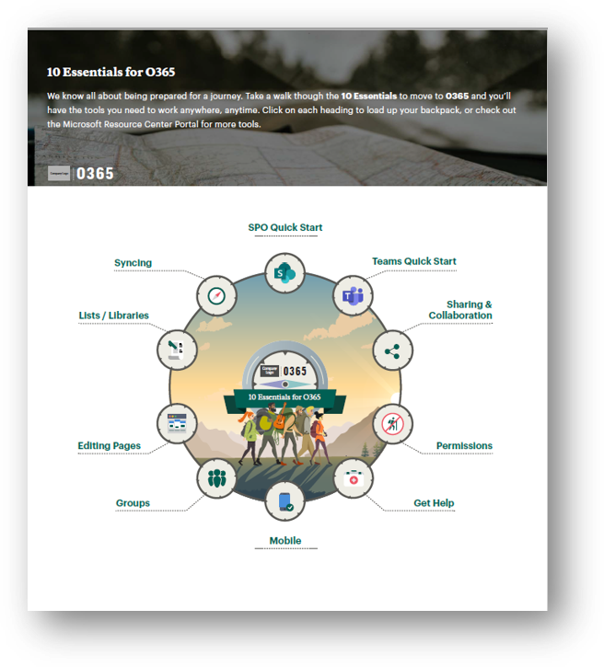
Retailer – Teams Training and Adoption
Business Need
A large retailer was using a mix of approved and unapproved communication and collaboration tools. They needed to consolidate everything into Microsoft Teams with clear governance, adoption support, and a structured roadmap. The audience included resistant users, making training and change management essential for success.
What We Did
Planned and executed a cross-functional rollout across technology, user adoption, and communications on an accelerated timeline
Delivered a multi-touch communication plan to prepare users for the transition and reduce resistance
Facilitated Teams training sessions, resources, and readiness materials tailored to different user groups
Partnered with leadership to reinforce consistent messaging and support long-term usage.
Results
All targeted users were transitioned successfully into the new Teams environment
Users who participated in training expressed confidence in adopting the new tools
The organization established a standardized collaboration platform with reduced tool sprawl
Leadership gained a clear governance model and communication framework for ongoing use.

